Slide 1
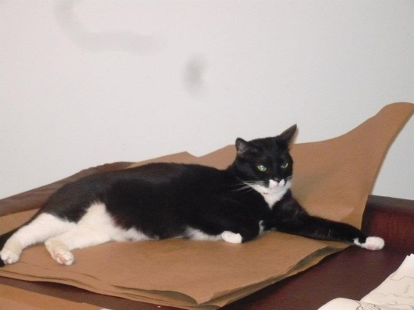
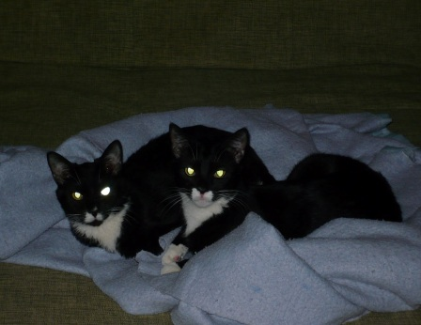
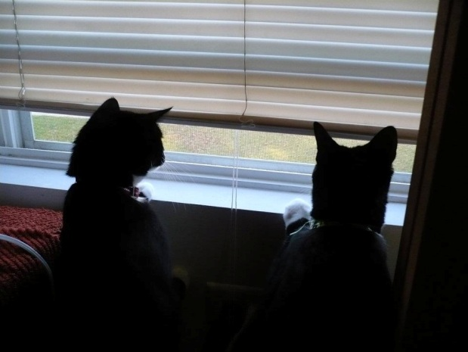
The story of Itsy and Bitsy
We were so happy to be rescued by Mommy. That street was miserable and she is so loving. Our home was fun and warm. We love lounging in the bed or on the couch with her.
And I love getting on all Mommy’s paperwork. Shhh . . . Don’t tell her.
I hope they are as nice as Mommy.
I wonder where we will go now.
Itsy and Bitsy are two three year old Tuxedo sisters (from the same litter) that I must adopt out as a couple as they are very close. Both are spayed but neither is NOT declawed. They are warm and friendly once familiar with you. Scary cats at first. They have been around children over 10 years of age and are fine although they have never been around babies. They have been around another cat and two dogs just fine after they’ve become familiar. I seek a warm and loving family who can afford them a long life of love. Please call me at 215-869-2237 my name is Hope. ☹ August, 2013

